Slide 1
Common circuits based on sequential storage devices
Sequential logic storage devices give us the ability to create sophisticated circuits that can make decisions based on the current and past values of the inputs
Simple circuits that can be created with only these storage devices.
Toggle Flop Clock Divider
Ripple Counter
Shift register

Slide 2
Toggle flop clock divider
A Toggle Flop is a circuit that contains a D-Flip-Flop configured with its Qn output wired back to its D input.
This configuration is also commonly referred to as a T Flip- Flop or T-Flop.
In this circuit, the only input is the clock signal.
Let’s examine the behavior of this circuit when its outputs are initialized to Q = 0, Qn = 1.
Since Qn is wired to the D input, a logic 1 is present on the input before the first clock edge.
Upon a rising edge of the clock, Q is updated with the value of D.
This puts the outputs at Q = 1, Qn = 0.

Slide 3
Toggle flop clock divider
With these outputs, now a logic 0 is present on the input before the next clock edge.
Upon the next rising edge of the clock, Q is updated with the value of D.
This time the outputs go to Q = 0, Qn = 1.
This behavior continues indefinitely.
The circuit is called a toggle flop because the outputs simply toggle between a 0 and 1 every time there is a rising edge of the clock.
This configuration produces outputs that are square waves with exactly half the frequency of the incoming clock.
As a result, this circuit is also called a clock divider.
This circuit can be given its own symbol with a label of “T” indicating it is a toggle flop.

Slide 4
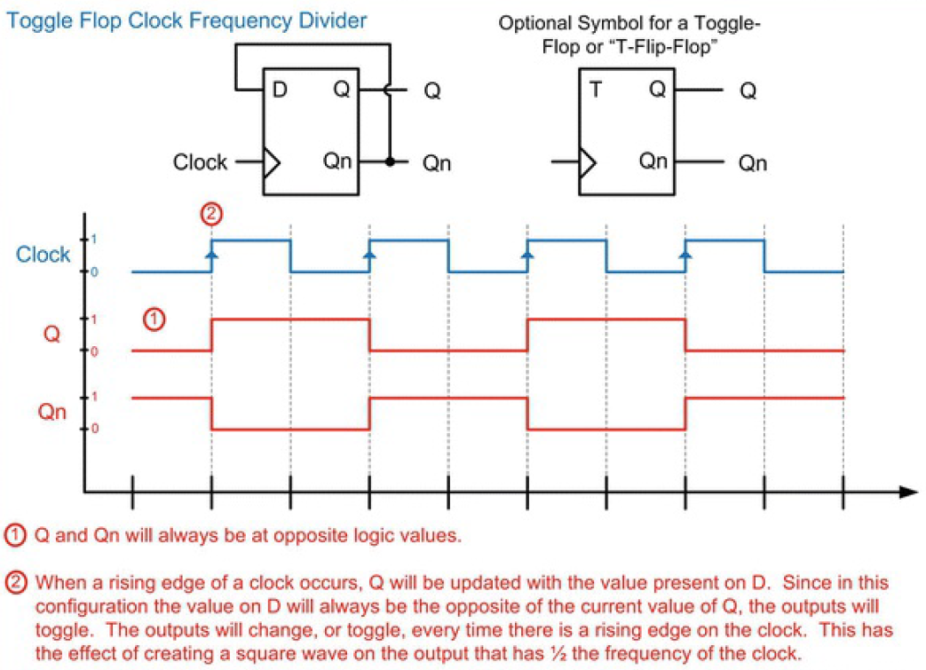

Slide 5
Asynchronous ripple counter
The toggle flop configuration can be used to create a simple binary counter called a ripple counter.
In this configuration, the Qn output of a toggle flop is used as the clock for a subsequent toggle flop.
Since the output of the first toggle flop is a square wave that is ½ the frequency of the incoming clock, this configuration will produce an output on the second toggle flop that is ¼ the frequency of the incoming clock.
This is by nature the behavior of a binary counter.
The output of this counter is present on the Q pins of each toggle flop.
Toggle flops are added until the desired width of the counter is achieved with each toggle flop representing one bit of the counter.
Since each toggle flop produces the clock for the subsequent latch, the clock is said to ripple through the circuit, hence the name ripple counter.
The clock input of all flops is not the same or the flops are not in sync with each other. So, it is also called asynchronous

Slide 6
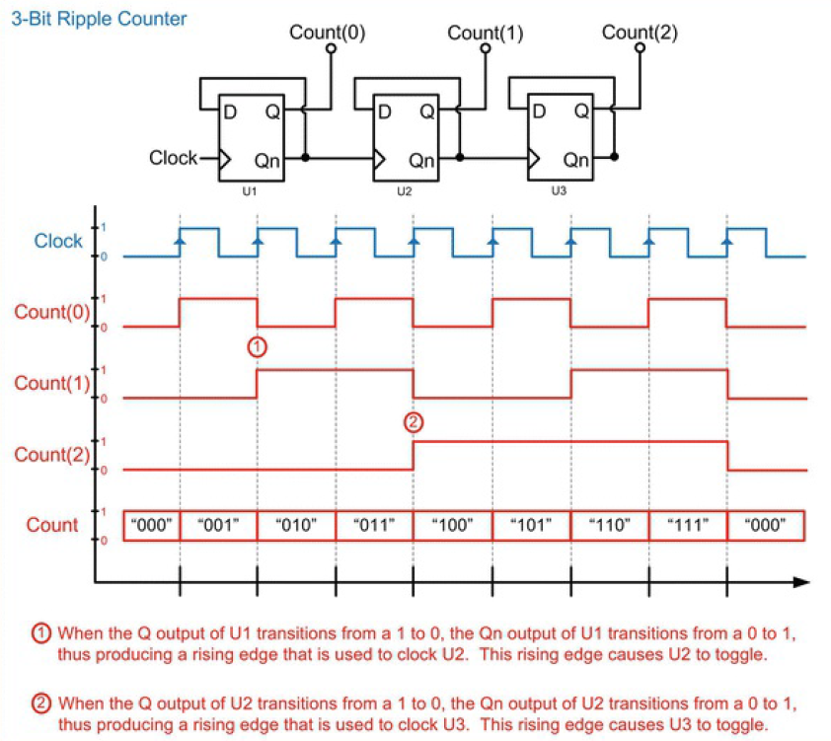

Slide 7
Shift register
A shift register is a chain of D-Flip-Flops that are each connected to a common clock.
The output of the first D-Flip-Flop is connected to the input of the second D Flip-Flop.
The output of the second D-Flip-Flop is connected to the input of the third D-Flip-Flop, and so on.
When data is present on the input to the first D-Flip-Flop, it will be latched upon the first rising edge of the clock.
On the second rising edge of the clock, the same data will be latched into the second D-Flip-Flop.

Slide 8
Shift register
This continues on each rising edge of the clock until the data has been shifted entirely through the chain of D-Flip-Flops.
Shift registers are commonly used to convert a serial string of data into a parallel format.
If an n-bit, serial sequence of information is clocked into the shift register, after n clocks the data will be held on each of the D-Flip-Flop outputs.
At this moment, the n-bits can be read as a parallel value.

Slide 9
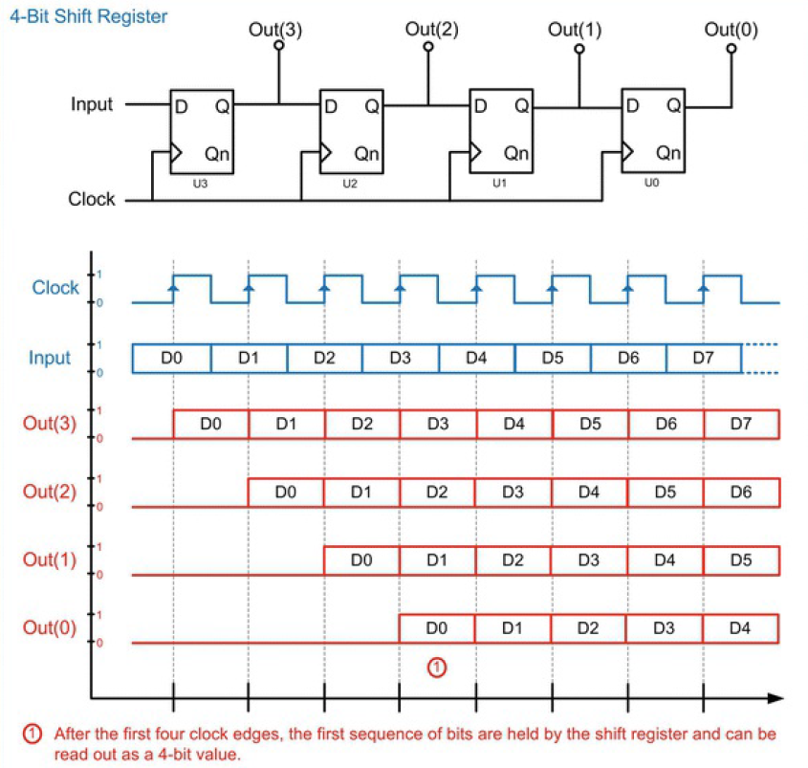

Slide 10
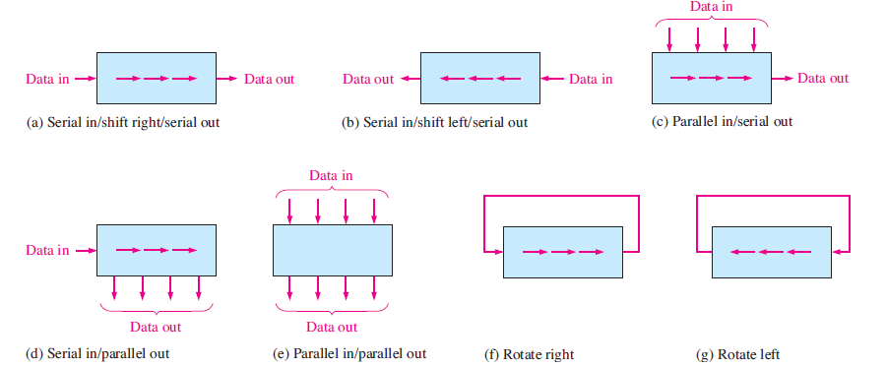
Basic data movement in shift registers

Slide 11
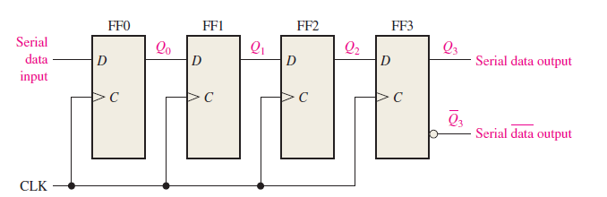
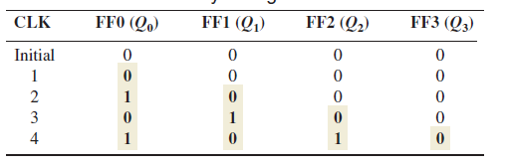
Serial In/Serial Out Shift Registers
Shifting a 4-bit code into the shift register
The serial in/serial out shift register accepts data serially—that is, one bit at a time on a single line. It produces the stored information on its output also in serial form.
The register is initially clear. The 0 is put onto the data input line, making D = 0 for FF0. When the first clock pulse is applied, FF0 is reset, thus storing the 0.

Slide 12
Serial In/Serial Out Shift Registers
Next the second bit, which is a 1, is applied to the data input, making D = 1 for FF0 and D = 0 for FF1 because the D input of FF1 is connected to the Q0 output. When the second clock pulse occurs, the 1 on the data input is shifted into FF0, causing FF0 to set; and the 0 that was in FF0 is shifted into FF1.
The third bit, a 0, is now put onto the data-input line, and a clock pulse is applied. The 0 is entered into FF0, the 1 stored in FF0 is shifted into FF1, and the 0 stored in FF1 is shifted into FF2.
The last bit, a 1, is now applied to the data input, and a clock pulse is applied. This time the 1 is entered into FF0, the 0 stored in FF0 is shifted into FF1, the 1 stored in FF1 is shifted into FF2, and the 0 stored in FF2 is shifted into FF3. This completes the serial entry of the four bits into the shift register, where they can be stored for any length of time as long as the flip-flops have dc power.

Slide 13
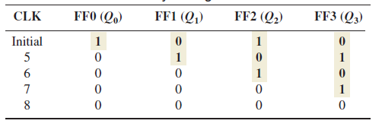
Serial In/Serial Out Shift Registers
After CLK4 in the data-entry operation just described, the LSB, 0, appears on the Q3 output. When clock pulse CLK5 is applied, the second bit appears on the Q3 output. Clock pulse CLK6 shifts the third bit to the output, and CLK7 shifts the fourth bit to the output. While the original four bits are being shifted out, more bits can be shifted in. All zeros are shown being shifted in, after CLK8.
Shifting a 4-bit code out of the shift register

Slide 14
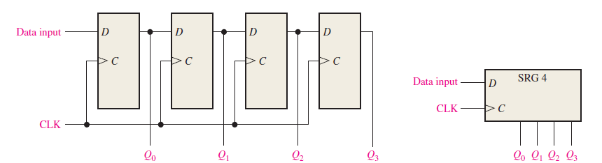
Serial In/Parallel Out Shift Registers

Slide 15
Serial In/Parallel Out Shift Registers
Data bits are entered serially (least-significant bit first) into a serial in/parallel out shift register in the same manner as in serial in/serial out registers.
The difference is the way in which the data bits are taken out of the register; in the parallel output register, the output of each stage is available.
Once the data are stored, each bit appears on its respective output line, and all bits are available simultaneously, rather than on a bit-by-bit basis as with the serial output.

Slide 16
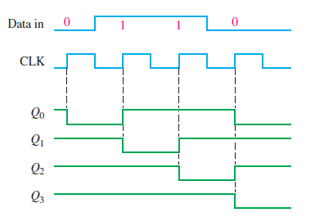
Serial In/Parallel Out Shift Registers
The register contains 0110 after four clock pulses for data input 0110

Slide 17
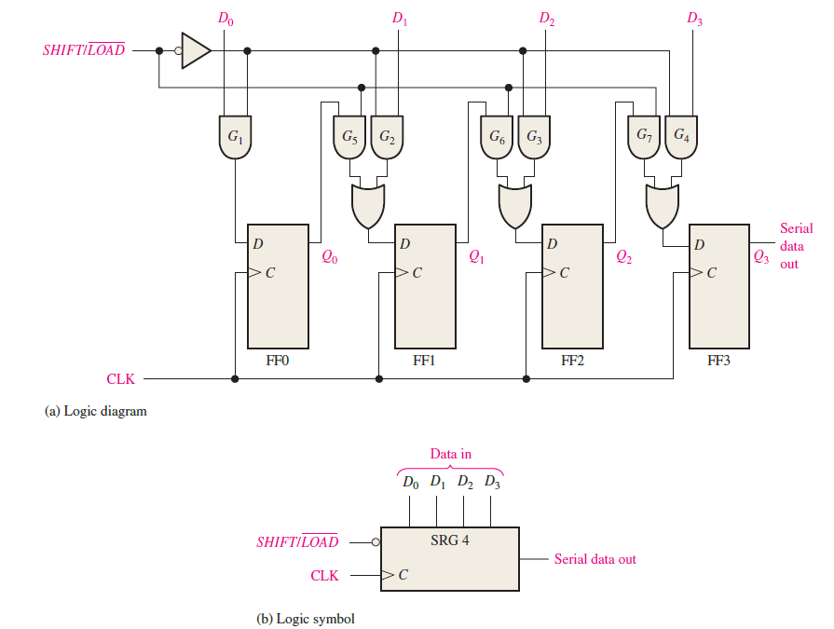
Parallel In/Serial Out Shift Registers

Slide 18
Parallel In/Serial Out Shift Registers
For a register with parallel data inputs, the bits are entered simultaneously into their respective stages on parallel lines rather than on a bit-by-bit basis on one line as with serial data inputs.
The serial output is the same as in serial in/serial out shift registers, once the data are completely stored in the register.
There are four data-input lines, D0, D1, D2, and D3, and a SHIFT/LOAD input, which allows four bits of data to load in parallel into the register.
When SHIFT/LOAD is LOW, gates G1 through G4 are enabled, allowing each data bit to be applied to the D input of its respective flip-flop. When a clock pulse is applied, the flip-flops with D = 1 will set and those with D = 0 will reset, thereby storing all four bits simultaneously.

Slide 19
Parallel In/Serial Out Shift Registers
When SHIFT/LOAD is HIGH, gates G1 through G4 are disabled and gates G5 through G7 are enabled, allowing the data bits to shift right from one stage to the next.
The OR gates allow either the normal shifting operation or the parallel data-entry operation, depending on which AND gates are enabled by the level on the SHIFT/LOAD input.
FF0 has a single AND to disable the parallel input, D0. It does not require an AND/OR arrangement because there is no serial data in.

Slide 20
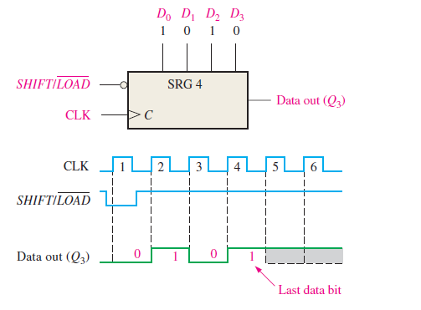
Parallel In/Serial Out Shift Registers
On clock pulse 1, the parallel data (D0D1D2D3 = 1010) are loaded into the register, making Q3 a 0.
On clock pulse 2 the 1 from Q2 is shifted onto Q3
On clock pulse 3 the 0 is shifted onto Q3;
On clock pulse 4 the last data bit (1) is shifted onto Q3; and
On clock pulse 5, all data bits have been shifted out, and only 1s remain in the register (assuming the D0 input remains a 1).

Slide 21
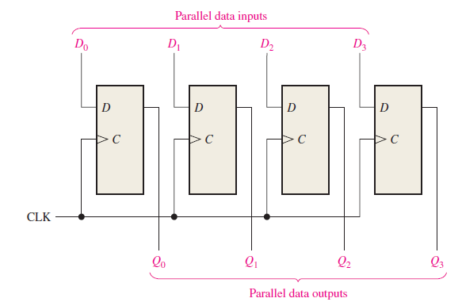
Parallel In/Parallel Out Shift Registers
Immediately following the simultaneous entry of all data bits, the bits appear on the parallel outputs. Data are entered simultaneously, and after a clock, the data are available at the output

Slide 22
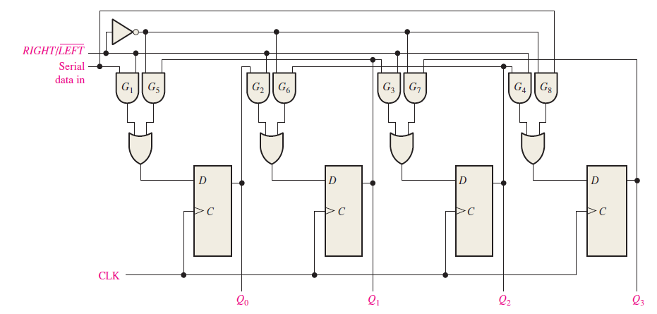
Bidirectional Shift Registers

Slide 23
Bidirectional Shift Registers
A bidirectional shift register is one in which the data can be shifted either left or right. It can be implemented by using gating logic that enables the transfer of a data bit from one stage to the next stage to the right or to the left, depending on the level of a control line.
A HIGH on the RIGHT/LEFT control input allows data bits inside the register to be shifted to the right, and a LOW enables data bits inside the register to be shifted to the left.
When the RIGHT/LEFT control input is HIGH, gates G1 through G4 are enabled, and the state of the Q output of each flip-flop is passed through to the D input of the following flip-flop. When a clock pulse occurs, the data bits are shifted one place to the right.
When the RIGHT/LEFT control input is LOW, gates G5 through G8 are enabled, and the Q output of each flip-flop is passed through to the D input of the preceding flip-flop. When a clock pulse occurs, the data bits are then shifted one place to the left

Slide 24
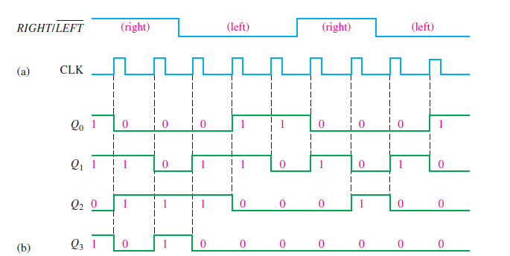
Bidirectional Shift Registers
Assume that Q0 = 1, Q1 = 1, Q2 = 0, and Q3 = 1 and that the serial data-input line is LOW.

